Slide 1
PARKING SPOTS ALLOCATION
Presentation and Detailed Report
Francisco Teixeira Lopes up201106912
Maria Eduarda Santos Cunha up201506524

Slide 2
Problem Description and Data Analysis
Former problem:
Our first project consisted of the allocation of parking lots to several cars. The cars had certain requirements regarding the kind of spot they preferred and negotiated with the various parking lots to assess which was the best one for them.
Current problem:
The problem now is to analyse the satisfaction of each car agent with their chosen parking lot.
This is a regression problem which will be analysed in RapidMiner by using a dataset with 1000 cars and varying parking lot configurations. These will be explained in detail later in the report.

Slide 3
Performed Experiments
The software developed for the first project was used with varying parameters to generate 10 sets of 100 cars with accompanying parking lots, which were handcrafted. This final set of 1000 data rows was used for regression in RapidMiner.
The configurations are stated later in the Additional Info section of the report, under the title Other Data.

Slide 4
Gathered Data Statistics
The CSV file generated from the software contains many columns and each stands for the following:
Zone<num>Parks
CheapZone<num>
ModerateZone<num>
PremiumZone<num>
CarZone
CarCost
CarDistance
CarType
Satisfaction
parks were divided in 9 districts of 5x5 boxes
each district was divided in 3 pricing ranges
the car agent’s starting district
the max hourly cost tolerated by the car agent
the max distance tolerated by the car agent
the behavior of the car type
the percentage rating of the satisfaction of the car client

Slide 5
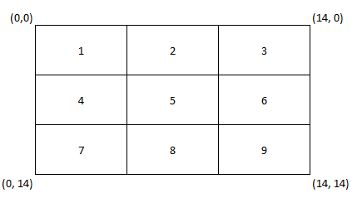
Gathered Data Statistics
Districts are divided in 5x5 boxes as follows:
Pricing ranges are divided in:
cheap (1 – 5)
moderate (6 – 10)
premium (11 – 15)
Car behaviors used are:
STRICT – must have both distance and cost conditions met
LOWERCOST – always goes for the lower cost up to a maximum
LOWERDIST – always goes for the lowest distance up to a maximum
FLEXIBLE – like STRICT but allows parking lots to demand more than its maximum tolerated up to a margin

Slide 6
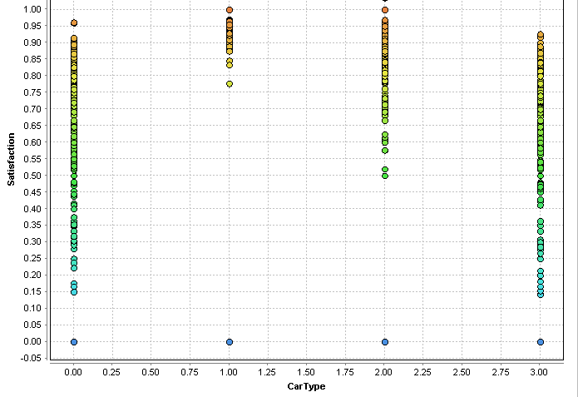
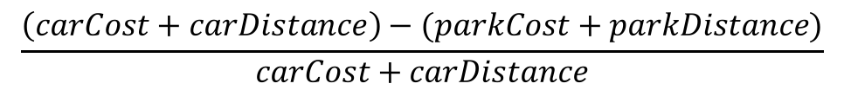
Gathered Data Statistics
Satisfaction is the dependent variable of this regression problem. It is calculated as follows:
STRICT
LOWERCOST
LOWERDIST
FLEXIBLE
$$\frac{\left(carCost+carDistance\right)−(parkCost+parkDistance)}{carCost+carDistance}$$
Satisfaction distribution per car type can be seen in the following graph from RapidMiner.
As expected, cars with LowerCost and LowerDist behavior are the most satisfied and Strict and Flexible the least satisfied.
Strict and Flexible have satisfaction level results scattered all the way from 0.15 up to 0.95, while LowerCost and LowerDist have more concentrated levels on the upper side of the scale.
Upper side (>=0.5)
Lower side (<0.5)

Slide 7
Data Analysis with RapidMiner
For the following slides, know that:
RMSE measures the difference between the actual values and the predicted values; RRSE compares the predictor used to a simple predictor (one that only uses the average of the actual values for prediction).
Note: Values from 0 to 1 represent a useful model.

Slide 8
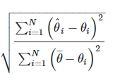
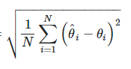
Data Analysis with RapidMiner
We used 4 kinds of regression models in RapidMiner. The following table shows the results obtained from those regressions.
Given this information, all of the models except the Polynomial Regression model, are useful being that the Neural Net performs the best out of the four.
Regression Type | Linear Regression | Polynomial Regression | Neural Net | Deep Learning | Formula
Root Mean Squared Error | 0.274 | 55.294 | 0.236 | 0.266
Root Relative Squared Error | 0.866 | 174.742 | 0.744 | 0.841
> 1
> 1

Slide 9
Conclusion
Analysis conclusion:
The dataset generated by our software contains data that can be analysed properly using regression models. We conclude that, given a sufficiently large set of data, RapidMiner or other machine learning softwares could reasonably estimate the output of our software without having to run the actual software.
Further work:
For future work, one could analyse other quality indicators of regression models such as different error measurements and correlation coefficients. Another idea would also be to expand the dataset with new columns relating to desired spot types of the car agents, parking lots’ available spot types and seeing how parking lot spots vacancy altered the results as, for this analysis, we considered parking lots had “infinite” capacity.

Slide 10
Additional Info

Slide 11
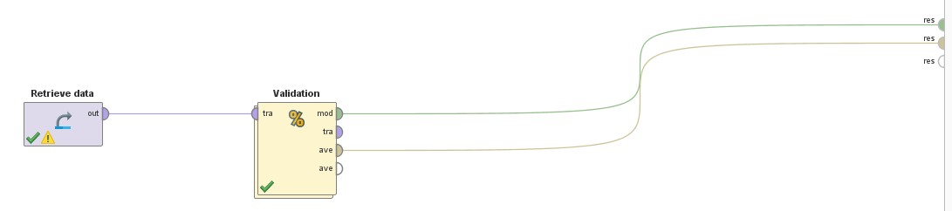
RapidMiner Processes
The data was imported to RapidMiner as a CSV file with its first line representing the header of the columns.
Satisfaction’s role was changed to “label” since it is our dependent variable. This data was then plugged into a SplitValidator to divide the dataset in Training and Testing sets for evaluating the performance of a chosen model.

Slide 12
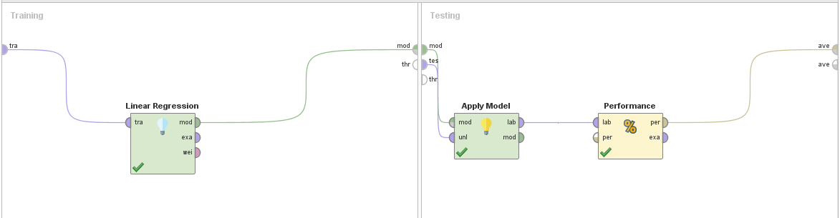
RapidMiner Processes
The dataset split was set to 0.7/0.3 (train/test) and a model was applied to the data (Linear Regression, Neural Net and so on). After applying the chosen model, a Performance operator was used to get the RMSE and RRSE of the applied model.

Slide 13
Other Data
Our config file, configInfo.txt, is composed of 10 different RUNs, each with different districts and corresponding price, and it shows all the parking lot configurations we used for testing.
RUN1
Zone1 | Cheap
Zone1 | Moderate
Zone9 | Moderate
RUN2
Zone1 | Cheap
Zone5 | Premium
Zone5 | Cheap
Zone9 | Moderate
RUN3
Zone4 | Premium
Zone2 | Moderate
Zone6 | Cheap
Zone8 | Cheap
RUN4
Zone1 | Cheap
Zone1 | Cheap
Zone1 | Premium
Zone7 | Moderate
Zone7 | Moderate

Slide 14
Other Data
RUN5
Zone5 | Cheap
Zone5 | Moderate
Zone5 | Moderate
Zone5 | Premium
RUN6
Zone3 | Cheap
Zone3 | Cheap
Zone7 | Moderate
Zone7 | Premium
RUN7
Zone2 | Cheap
Zone2 | Moderate
Zone2 | Cheap
Zone8 | Moderate
Zone8 | Premium
RUN8
Zone4 | Cheap
Zone4 | Premium
Zone5 | Cheap
Zone5 | Moderate
Zone6 | Moderate
Zone6 | Premium

Slide 15
Other Data
RUN9
Zone8 | Cheap
Zone8 | Moderate
Zone2 | Premium
Zone2 | Cheap
RUN10
Zone2 | Cheap
Zone2 | Moderate
Zone7 | Moderate
Zone7 | Premium
Zone9 | Moderate
Zone9 | Cheap

Slide 16
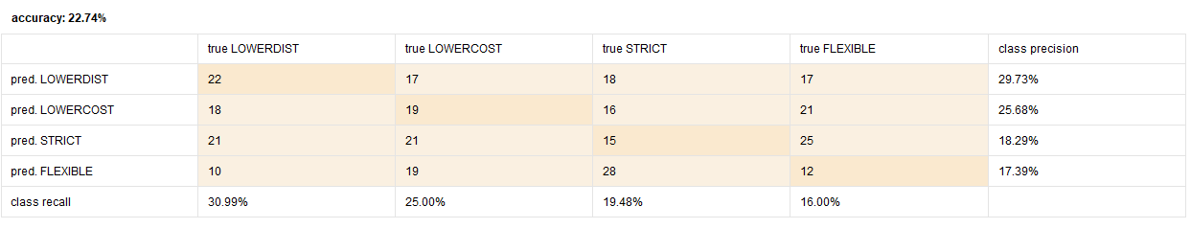
Other Observations
Classification using kNN was also performed, switching the dependent variable from Satisfaction to CarType, i.e. , for a given configuration we wanted the model to predict the CarType.
The confusion matrix evaluated an accuracy of 22.74% which means this model is not useful and, considering a random selection would roughly equal ~50% meaning, this model is even worse than a random predictor.

